Slide 1
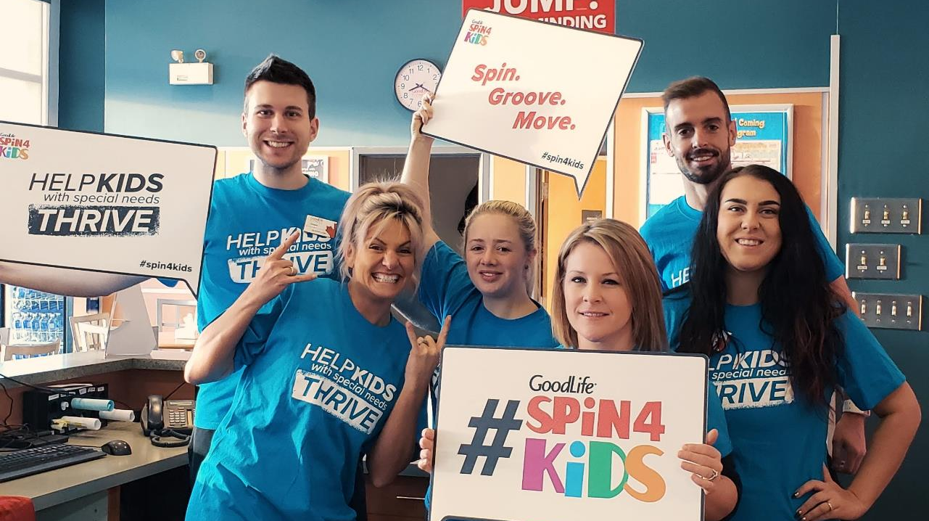
Spin4Kids Onboarding Call 2 September 2019
September 2019
#Spin4Kids
Notes:
Welcome, thanks for joining us
This is our second onboarding call. If you missed the first, we have the slides available on Pulse and on the Event Portal
Today we’ll cover more details to help with your Spin4Kids planning
We’ll have time at the end for questions
Please mute yourselves so we don’t get any background noise
Please don’t put us on hold – it’ll play the GoodLife hold music for everyone on the call if you do

Slide 2
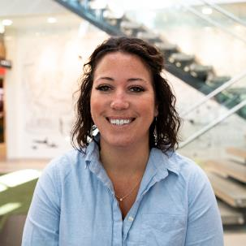
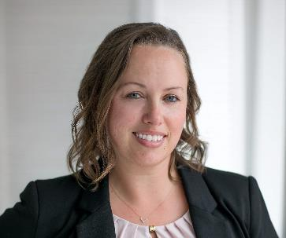
Main contacts
Kendall O’Neill
Fundraising & engagement
kendall.oneill@goodlifekids.com
519-661-0190 x 6325
Tara McGuire
Spin4Kids national logistics & spin4kids.com support
tmcguire@goodlifekids.com
519-661-0190 x 6623
Notes:
I’d like to introduce you to the GoodLife Kids Foundation team
We have 4 people on our team, and we’re happy to help with your Spin4Kids planning
Kendall O’Neill just joined our team last month, and will be your go-to contact for fundraising
Tara McGuire looks after all the Spin4Kids national logistics and spin4kids.com support

Slide 3
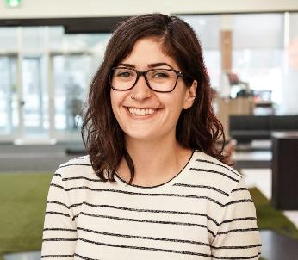
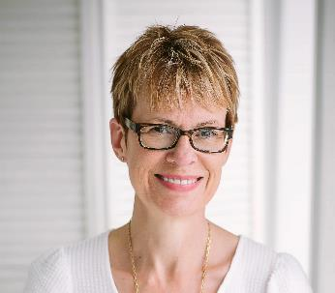
Additional support
Laura Haggart
Marketing and communications
laura.haggart@goodlifefitness.com
519-661-0190 x 6354
Lisa Burrows
Executive Director
lburrows@goodlifekids.com
519-661-0190 x 6273
Notes:
Laura Haggart handles marketing and communications
And I’m Lisa Burrows, the GoodLife Kids Foundation Executive Director

Slide 4
Table of Contents
1
Registration and Fundraising
2
Marketing and Social Media
3
Depositing Funds
4
Local Vendors and Sponsors

Slide 5
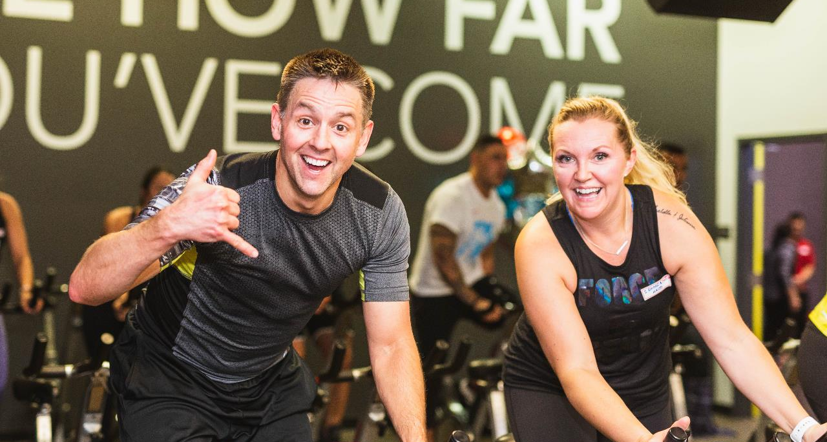
Registration and
Fundraising

Slide 6
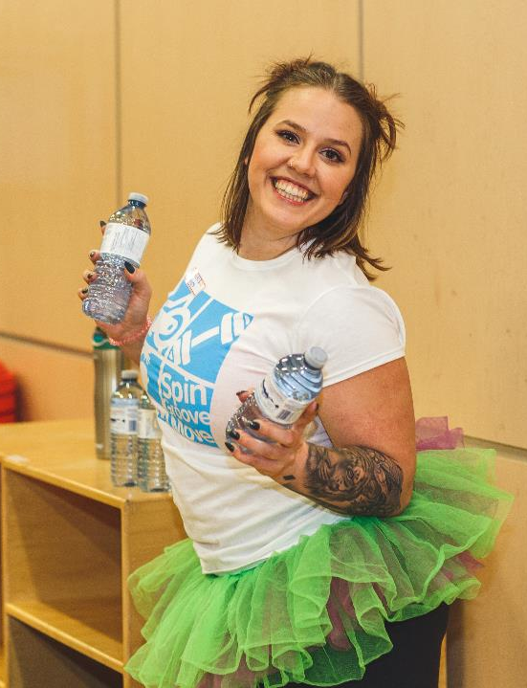
Registration
Spin4Kids is open to EVERYONE! Anyone can register, including GoodLife Members, non-Members, family, friends and Associates
Set a fundraising goal for your Club. How many Participants do you need to reach that goal?
Don’t forget to register and fundraise yourself!
Notes:
Anyone and everyone can register. GoodLife Members, non-Members, family, friends and Associates
Set a fundraising goal for your Club. How many Participants do you need to reach that goal? What other fundraising activities can you plan?
Check out “Tips and Tactics for Recruiting Participants” and “How to Fundraise $5,000” on Pulse and on the Event Portal
Don’t forget to register and fundraise yourself!

Slide 7
Registration
Everyone can help recruit Participants! All Club Associates should know:
Date, time, location
What activities are taking place
Spin4Kids is a fundraising event
Where funds go
How to register
Notes:
Everyone can help recruit fundraising Participants!
Make sure all Associates in your Club are prepared with answers if they’re approached about Spin4Kids
Associates should know:
-Date, time, and location of Spin4KIds
-What activities are taking place
-Spin4Kids is a fundraising event
-Where funds go
-How to register

Slide 8
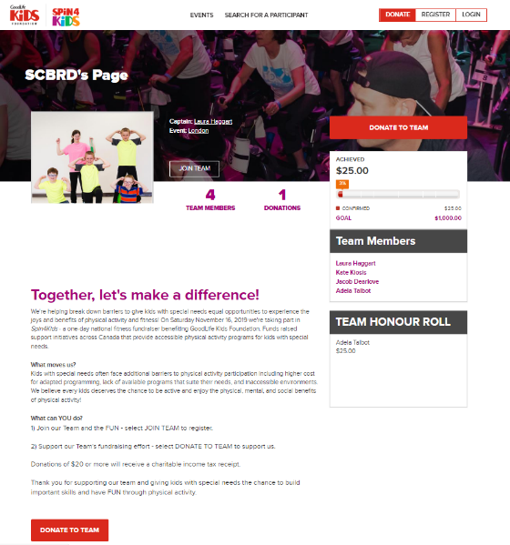
Fundraising
Encourage Participants to fundraise. All Participants are expected to fundraise a minimum of $125
Participants can register at spin4kids.com, where they can easily collect donations through our online platform
Notes:
Encourage Participants to fundraise.
All Participants are expected to fundraise a minimum of $125
Participants can register at spin4kids.com, where they can easily collect donations through our online platform
We have lots of tools to help fundraisers reach their goals. Review the Fundraising section on Pulse and the Event Portal

Slide 9
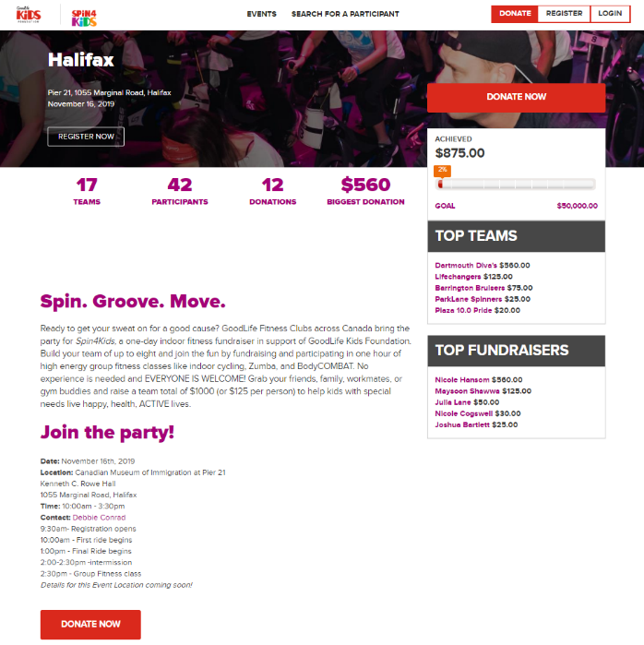
Your event page
Help us promote your local event! Provide details we can share on your event page:
Event Day schedule
Group Fitness Instructors leading sessions
Other activities taking place on November 16
Contact name
Make sure your event schedule is up to date!
Notes:
An up-to-date event page on spin4kids.com is a great way to help recruit Participants
Help us promote your event by providing details we can share on your event page
Make sure the schedule for your event is up to date. Participants will want to know what they’re signing up for
In this example here, Halifax has done a great job showing the day’s agenda, the start and end time, the address, and the contact

Slide 10
Stay tuned…
We have a surprise fundraising campaign coming October 1!
Details to come late September
Notes:
Stay tuned!
We have a national fundraising campaign coming October 1
Details to come late September

Slide 11
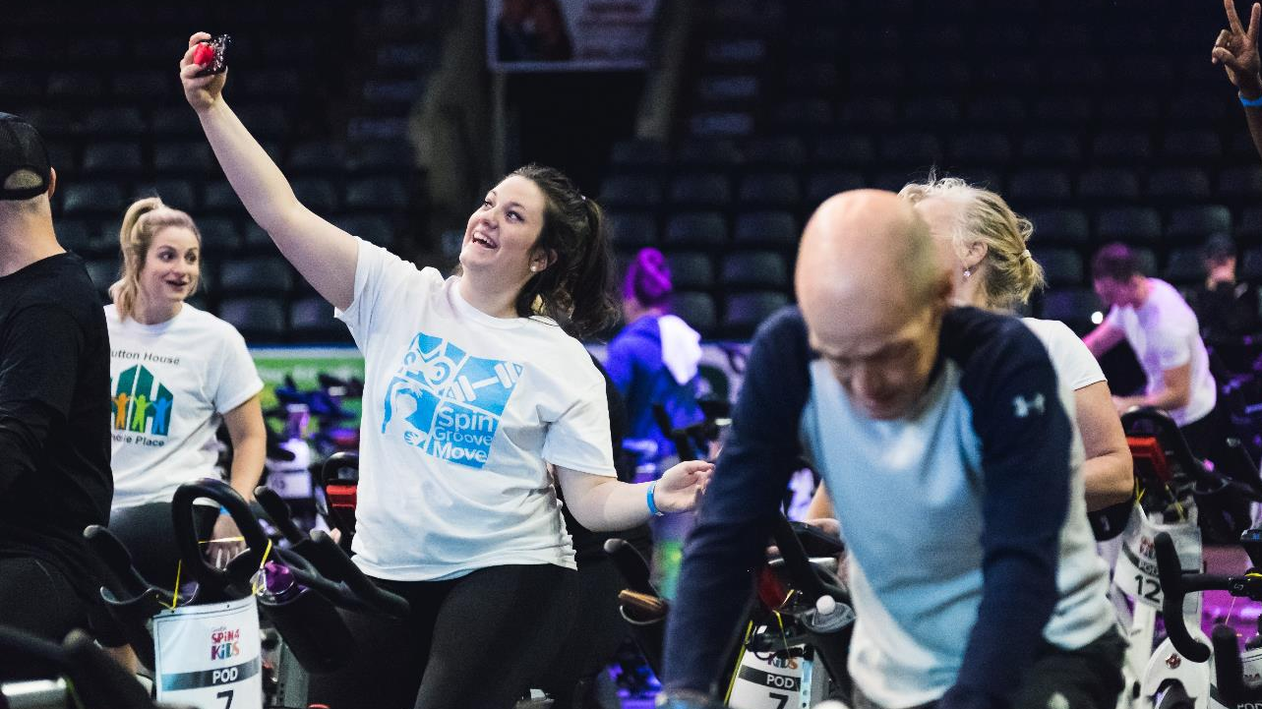
Marketing and
social media

Slide 12
Monthly marketing material
Leading up to Spin4Kids, you will receive marketing material to display in your Club
September
Rack Cards, Easel Stands, and “Sponsor Me!” Business Cards
October
Promo Posters, Pin Up Cards, and Fundraising Thermometers
November
Motivator T-Shirts
Notes:
Leading up to Spin4Kids, you will receive marketing material to display in your Club
Earlier this week, your Club should have received your September materials: Rack Cards, an Easel Stand, and “Sponsor Me!” Business Cards
In October, you’ll get Promo Posters, Pin Up Cards, and Fundraising Thermometers
And in November, you’ll get t-shirts for your Motivators to wear leading up to the big day

Slide 13
GoodLife TV
We will have three GoodLife TV spots leading up to Spin4Kids:
30-second promo video
Lift for Kids advertisement
Grant Program application advertisement
Notes:
We will have three GoodLife TV spots leading up to Spin4Kids:
30-second Spin4Kids promo video
Lift for Kids advertisement shown only in Clubs that are participating in or hosting Lift for Kids events
Grant Program application advertisement

Slide 14
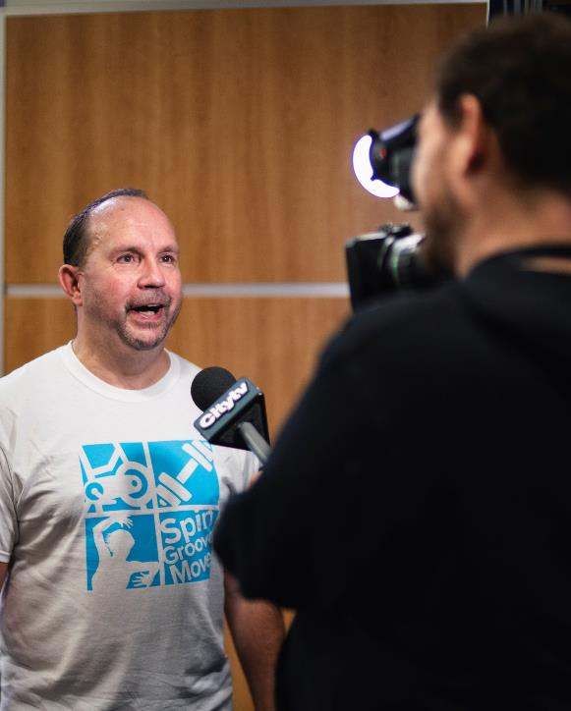
Media outreach
National media coverage is taken care of by GoodLife Kids Foundation
Local coverage is up to you! We’ll provide templates to get you started
Notes:
We’ll send out a national media release at the end of September to all cities with Spin4Kids events
We will provide Event Leaders and Club Champions with Event Advisory templates closer to November that you can distribute to your own local media

Slide 15
Social media tiles
Social media tiles are available to download on the Event Portal and on Pulse
Each class/activity has a tile, including Lift for Kids
Notes:
We’ve created social media tiles that you can use to promote your Spin4Kids event
Download them on the Event Portal and on Pulse
Feel free to use whichever tile resonates best with your audience
Please refer to “Social Media Guidelines” on Event Portal and Pulse
Email Laura at laura.haggart@goodlifefitness.com if you have questions

Slide 16
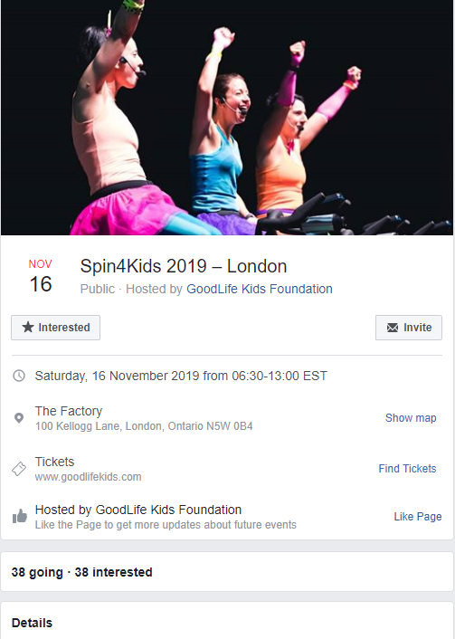
Facebook events
Please work with Laura to set up an official Facebook event through the GoodLife Kids Foundation Facebook page
An official event ensures everything is on brand and centralized
We want to help get as many people attending your event as possible!
Notes:
Facebook events are a great way to get the word out and invite people to your event
Work with Laura to create an official Facebook event for your event
An official event will ensure everything is on brand
If it’s created by GoodLife Kids Foundation, it’ll show up in a list on our Facebook page, helping to reach even more people
You can post in the event and invite people We want to work with you to make sure you get as many views on your event as possible

Slide 17
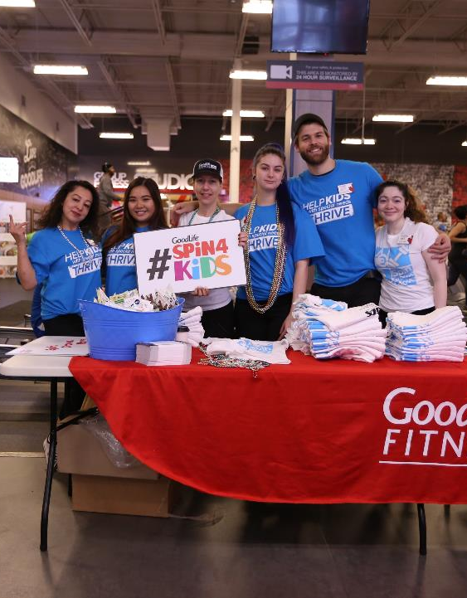
Share your photos!
Use #Spin4Kids and tag @GoodLifeKids on Facebook and Twitter and @GoodLifeKids_Fdn on Instagram
Want to see your event included in our GoodLife Kids Foundation marketing? Email your photos to Laura at laura.haggart@goodlifefitness.com
Notes:
Leading up to, during, and after your event, use #Spin4Kids and tag us on Facebook, Twitter, and Instagram
We’ll be using your photos after the event on our website, social media, Editor emails, print material, and GoodTimes magazine!
To make sure your event is included, email your photos and videos to Laura at laura.haggart@goodlifefitness.com

Slide 18
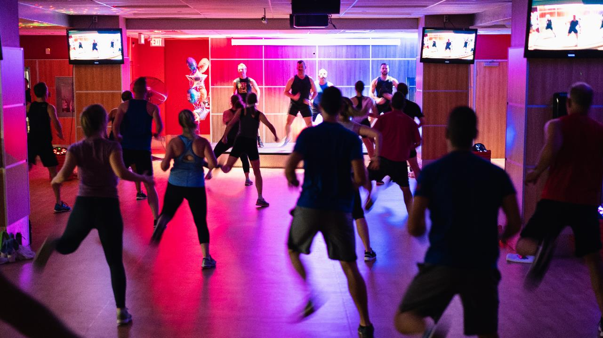
Depositing
Funds

Slide 19
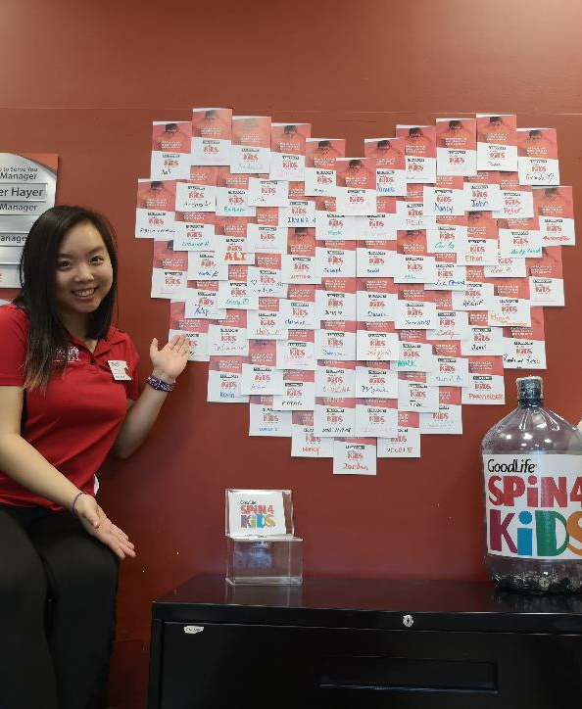
Cash & cheque donations
YES you can accept cash in Clubs for Spin4Kids!
Use pledge forms to track all donations
Deposit cash and cheques from both your Participants and your Club’s fundraising events into the GoodLife Kids Foundation account at RBC
Deposit slips and instructions are arriving in Clubs this month. Contact events@goodlifekids.com if you need more
Notes:
Yes, you can accept cash and cheques in Clubs!
Any cheques should be made payable to GoodLife Kids Foundation
Please record all donations on a pledge form
Income tax receipts will be issued for donations of $20+ 6-8 weeks after Spin4Kids
Deposit cash and cheques from both your Participants and your Club’s fundraising activities into the GoodLife Kids Foundation account at RBC
Deposits should be made often
Deposit slips and instructions are arriving in Clubs this month

Slide 20
What Participants can do with cash
Add it online
Participants can add cash donations to their online fundraising using their personal credit card to “pay it in”
Log into spin4kids.com and go to the “Offline Pledge Tab”
Once they’ve paid online using their credit card, they can keep the cash to reimburse themselves
Participants must get the donor’s information (donation amount, donor name, mailing address) to add the donation online
Bring it to Club
Participants can bring cash donations, along with a completed pledge form, to the Club before or on Event Day
Participants must get the donor’s information (donation amount, donor name, mailing address)
Notes:
Participants can submit cash donations in two ways.
First, they can add it online using their personal credit card. Here’s how:
Log into spin4kids.com and go to the “Offline Pledge Tab”
Pay the donation using their credit card, and keep the cash to reimburse themselves
Note: Participants must use the donor’s information to add the donation online
Second, they can bring the donations into the Club
They can do this on Event Day, or before
They must bring a completed pledge form
Note: Participants must get the donor’s information (donation amount, donor name, mailing address)

Slide 21
Lump sums
Lump sums are funds collected from fundraising activities like book sales, office pools, bottle drives, etc. These funds are not eligible for income tax receipts.
Our new online fundraising platform does not allow you to add lump sums online. Participants should submit these funds in Club or bring them on Event Day with a completed pledge form.
If your Club holds a fundraising activity, you cannot add the cash online. You must deposit all funds into the GoodLife Kids Foundation RBC account and send deposit slips and pledge forms to GoodLife Kids Foundation.
If you have questions, please email events@goodlifekids.com
Notes:
Lump sums are funds collected from fundraising activities like book sales, office pools, bottle drives, etc
These funds are not eligible for income tax receipts
Please note our new online fundraising platform does not allow you to add lump sums online. This is a change from last year
Participants should submit these funds in Club or bring them on Event Day with a completed pledge form
If your Club holds a fundraising activity, you cannot add the lump sum cash online
You must deposit all funds into the GoodLife Kids Foundation RBC account and send deposit slips and pledge forms to GoodLife Kids Foundation
If you have questions, please email events@goodlifekids.com

Slide 22
Paperwork & deposits
All paperwork and deposits are due November 22, 2019
We’ll take the cash and add it to the appropriate team, Participant and event online total
Final fundraising totals will be calculated in December
Notes:
Please submit all paperwork and deposits on the Friday following Spin4Kids – November 22, 2019
Absolute deadline is November 30
We’ll add it to the appropriate team, Participant, and event online fundraising total
Final fundraising totals will be calculated in December

Slide 23
Local Vendors and
Sponsors

Slide 24
Securing vendors
Local vendors
Please secure approval for potential vendors before you approach them. This will ensure the following:
The vendor doesn’t conflict with existing GoodLife or GoodLife Kids Foundation partners
The vendor pays the appropriate fee
Your Spin4Kids event is credited and the vendor fee will be added to your event’s fundraising total
Get approval by emailing Kendall O’Neill at kendall.oneill@goodlifekids.com. Vendors must be approved by October 31.
Vendor requirements
Vendors must complete the following:
Pay $150 vendor fee
Complete a Vendor Agreement
Provide proof of insurance
Please review “Vendor Policy and Guidelines” on Pulse and on the Event Portal
Notes:
If you want to have local vendors come to your Spin4Kids event, please get approval first
To get approval, email Kendall O’Neill at kendall.oneill@goodlifekids.com
Vendors must be approved by October 31
Please note: ALL vendors need to be approved, including rewards partners
Please note: Due to a partner that GoodLife Fitness has, we cannot have any supplement retail businesses as Spin4Kids vendors
Vendors must do three things.
Pay $150
Complete a vendor agreement
Provide proof of insurance
For more information, please review “Vendor Policy and Guidelines” on Pulse and on the Event Portal

Slide 25
Sponsorship levels
$150 Level - Vendor
Booth at Spin4Kids
$250 Level
Booth at Spin4Kids
Team of up to 2 Participants with company bike area
$500 Level
Booth at Spin4Kids
Logo on local 11.5” x 8.5” poster
Team of up to 4 Participants with company bike area
$1,000 Level
Booth at Spin4Kids
Logo on local 11.5” x 8.5” poster
Logo on local area email blast
Team of up to 8 Participants with company bike area
Local sponsors
Questions?
Email Kendall O’Neill at kendall.oneill@goodlifekids.com
Notes:
You are welcome to pursue sponsors for your event. There are 4 levels of sponsorship and different perks for each one.
$150 Level - Vendor
Booth at Spin4Kids
$250 Level
Booth at Spin4Kids
Team of up to 2 Participants with company bike area
$500 Level
Booth at Spin4Kids
Logo on local 11.5” x 8.5” poster
Team of up to 4 Participants with company bike area
$1,000 Level
Booth at Spin4Kids
Logo on local 11.5” x 8.5” poster
Logo on local area email blast
Team of up to 8 Participants with company bike area

Slide 26
Next Steps
November 22
Today!
?
October 7
November 16
November 30
Second onboarding call
Third and final onboarding call
Spin4Kids Event Day!
Paperwork and deposits due to GoodLife Kids Foundation
Cutoff date for Fundraising Rewards
Notes:
We’re getting closer to Spin4Kids event day!
Our third and final onboarding call will take place October 7
Then of course, Spin4Kids is happening November 16
After that, please note that paperwork and deposits are due the following Friday, November 22
Cutoff date for Fundraising Rewards is November 30

Slide 27
Questions?
events@goodlifekids.com
519-661-0190 x 6623

